Slide 1


"The journey is easier when it’s Marc’d"

Slide 2
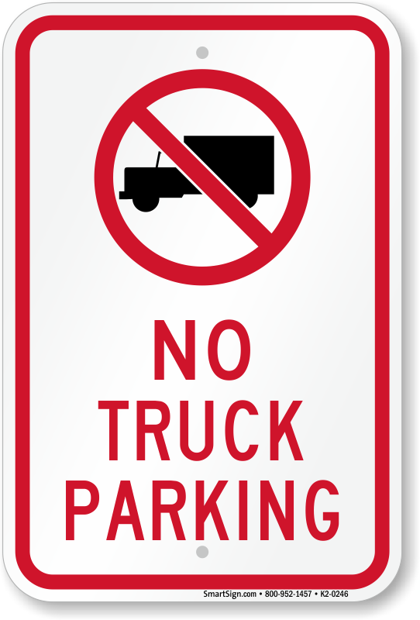


Problem
Severe shortage of safe, authorized parking
(1 spot for every 11 trucks)
Avoidable CSA violations, fines, & penalties
(rose 12.5% YOY in 2023)
Risk Exposure
(4% increase in labor costs)

Slide 3



Solution
Real-time parking availability
Safer & Happier Drivers
Lower Risk

Slide 4
Market Opportunity
Number of U.S. Truck Drivers | Industry-related Jobs
3.7 M | 8.5 million
(Source: U.S. Department of Transportation, 2022) | (Source: American Trucking Associations, 2021)
Commercial Auto Insurance Industry | Active Motor Carriers
$71.6 billion CAGR: 3.9% | 764K CAGR: 9%
(Source: IBISWorld, 2024) | (Source: FMCSA.DOT.GOV, 2024)
(Source: American Trucking Associations, 2021)
*Data gathered from the American Trucking Associations and the U.S. Department of Transportation.

Slide 5
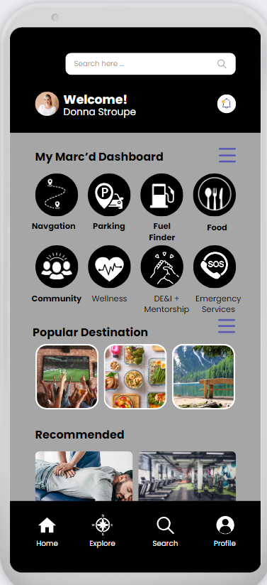

Product Features
Real-time Parking Solutions
Integrates with a network of sensors and data sources to provide users with up-to-the-minute information on available parking spaces, allowing them to locate authorized spots conveniently.
Voice-Activated Controls
Hands-free commands allow drivers to interact with the app safely while on the road.
Speed Monitoring Alerts
Tracks when drivers exceed the posted speed limit by over 5 miles per hour, alerting them to reduce speed and helping carriers ensure safe driving practices.
Spotter Request Assistance
Allows drivers to request assistance from nearby drivers when backing into challenging spaces or when visibility is limited.

Slide 6

Business Model
45%
30%
Monthly Subscription (Insurance Brokers): $21.99/month. This provides full access to the app for one driver under the insurer’s network and promotes safety and compliance.
Monthly Subscription
(Trucking Companies): $10.99/month for full, ad-free access and premium features, or $5.99/month with participating insurance provider discount.
Freemium Option
(Truckers):
Free, ad-supported access with navigation and community updates. Premium features (police alerts, parking) available for $1.99-$4.99 each.
12%

Slide 7




Marketing Strategy
Word-of-Mouth Campaigns
Insurance Brokers Partnerships
Influencer Partnerships
Trade Shows

Slide 8
Competitive Advantage
Comprehensive, Driver-Centered Solutions:
Unlike competitors focusing solely on navigation or parking, we address multiple driver pain points by providing safe parking, clean facilities, healthy food options, and roadside assistance.
Voice-Activated Controls
Hands-free commands allow drivers to interact with the app safely while on the road.
Compliance Monitoring Tools:
Track and report driver behavior, helping small fleets and owner-operators proactively manage CSA scores, avoid violations, and maintain compliance.
Spotter Request Assistance
Allows drivers to request assistance from nearby drivers when backing into challenging spaces or when visibility is limited.

Slide 9
Financial Plan
Year | Monthly Active Users | Monthly Projected Subscribers | Revenue | Expenses | Net Profit | Profit Margins
Year 1 | 22.5 K | 2.2 K | $768 K | $743 K | $25 K | 3%
Year 2 | 112.5 K | 16.9 K | $4.7 M | $4.0 M | $679 K | 14%
Year 3 | 224.9 K | 47.2 K | $12.0 M | $9.6 M | $2.4 M | 20%

Slide 10

Vision
At Marc'd, our mission is to transform the lives of truck drivers by providing them with innovative solutions and support. As we look to the future, we invite our partners to join us in this journey, empowering these hardworking individuals and driving positive change within the industry.
"The journey is easier when it’s Marc’d"

Slide 11
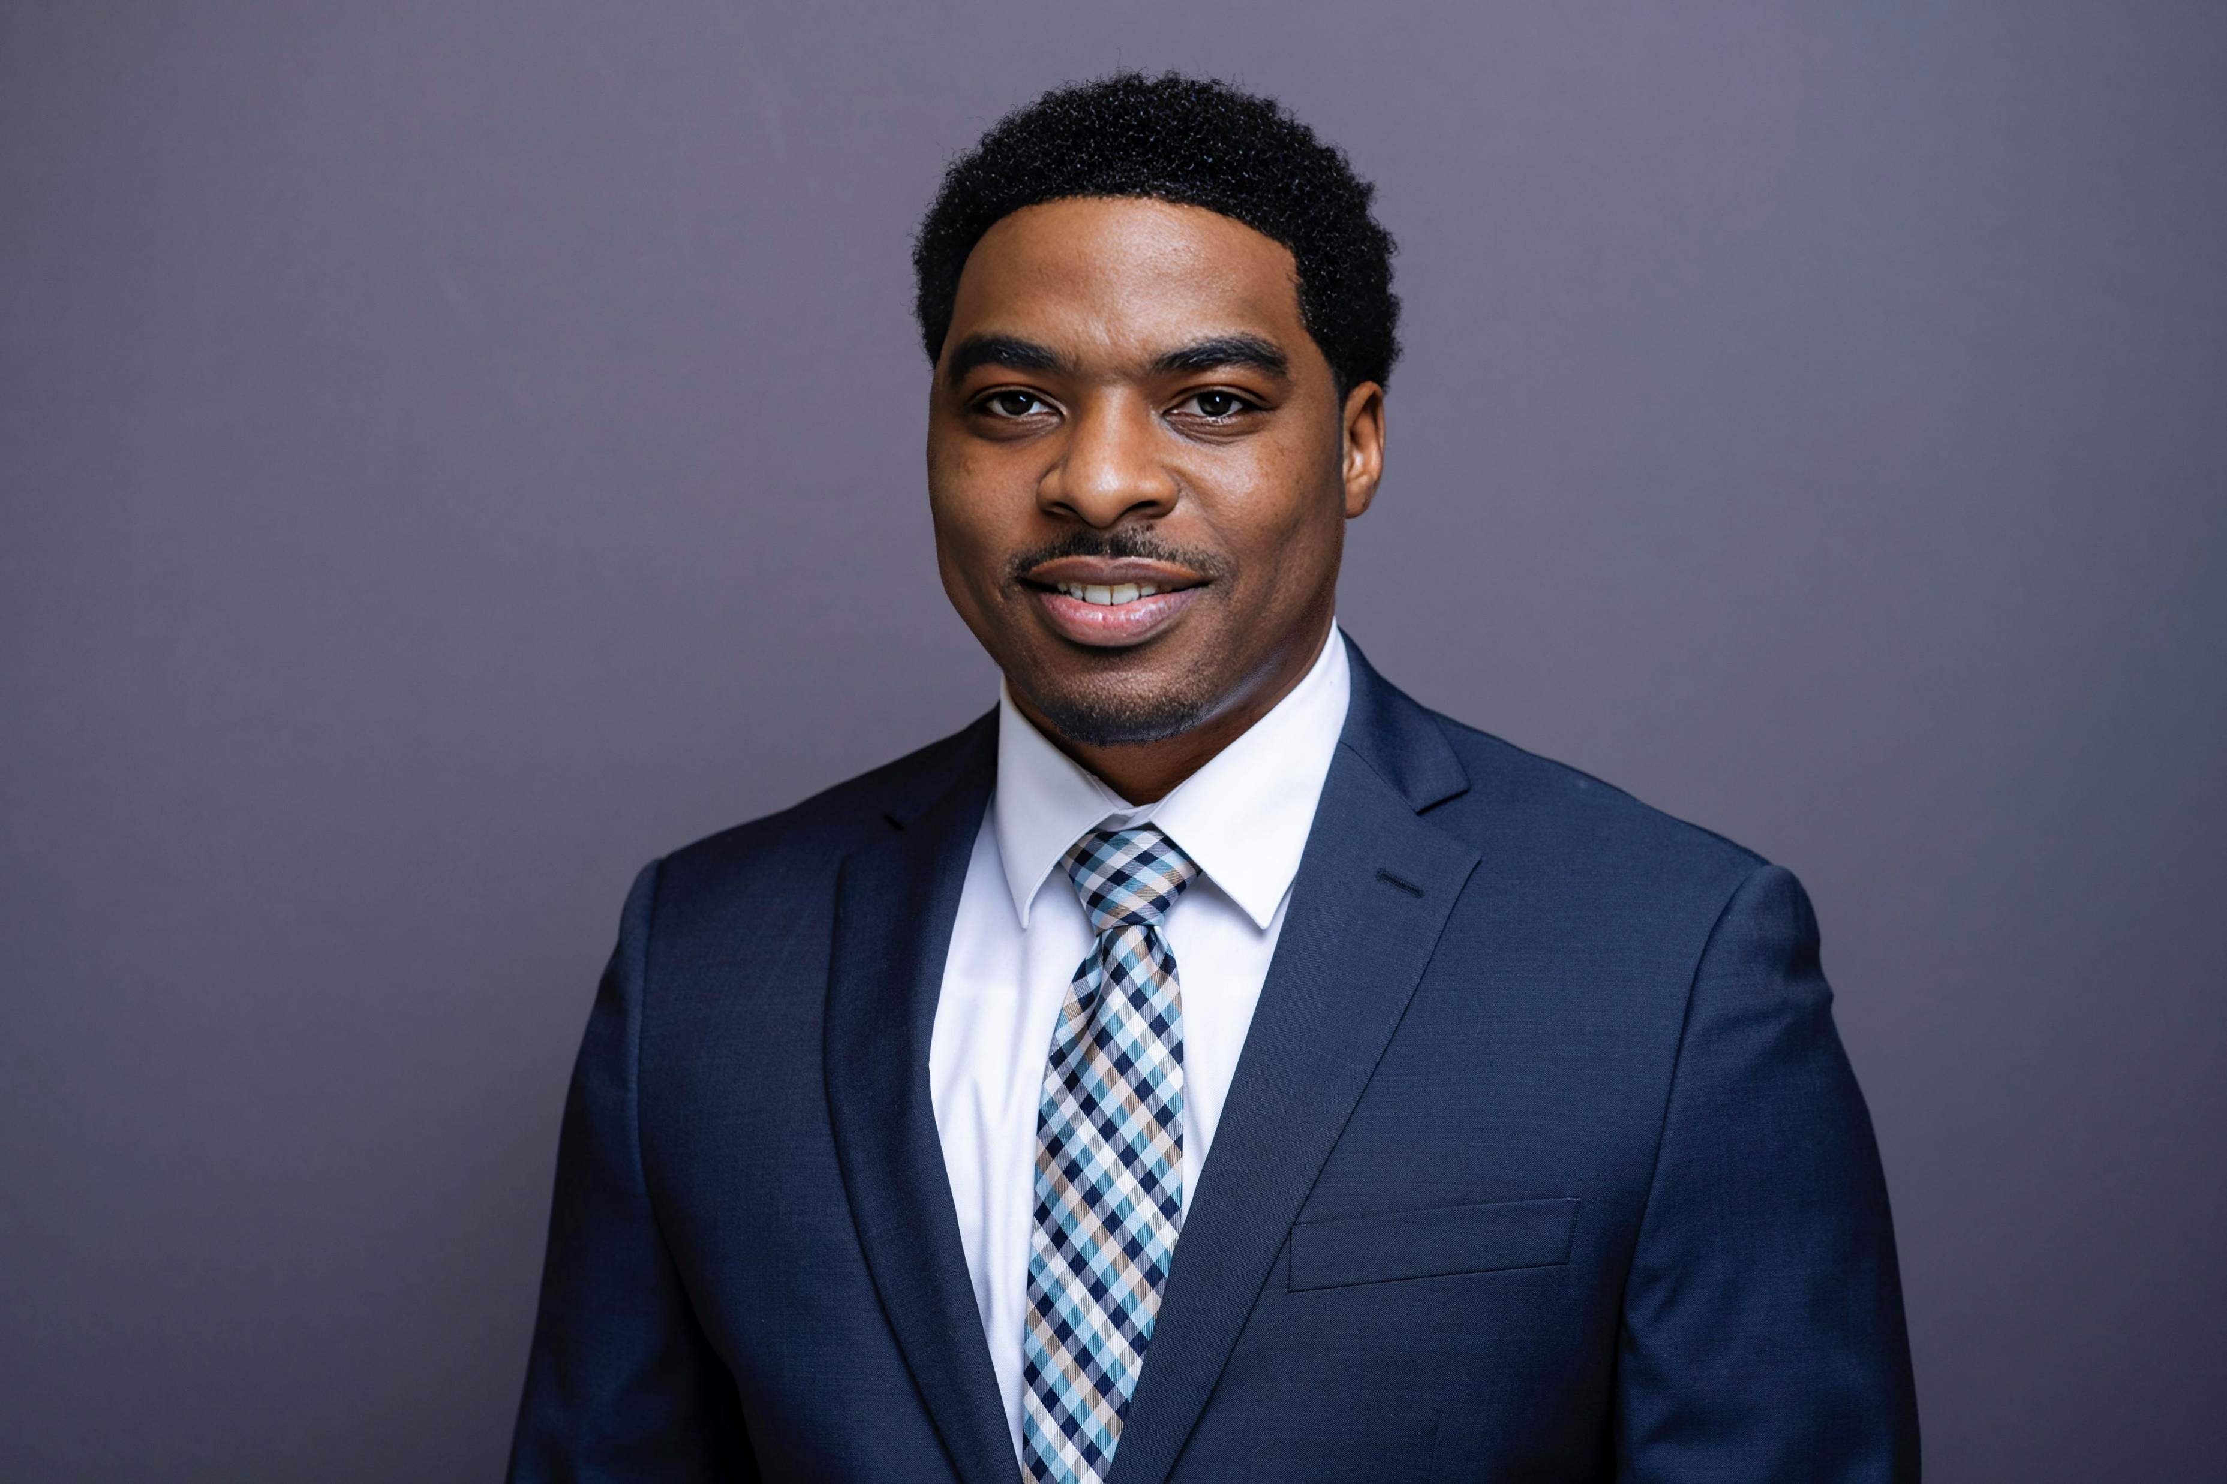
Team
Cartez Dewberry
Founder and CEO
Co Founder
Chief Technology Officer

Slide 12




Funding Ask
Funding Amount
Use of Funds
Growth Opportunities
Return on Investment
Requesting $130,000 in seed funding to develop a mobile app.
Allocating 90% towards hiring app developers, 10% towards marketing
The secured funding will enable us to target a 30% increase in customer base and a 25% expansion in revenue within the next 18 months.
Projecting a 2-year payback period and a 25% annual return on the invested capital, based on our financial projections and growth strategy.
The requested funding will be instrumental in scaling our business and capitalizing on the identified growth opportunities, ultimately delivering a strong return on investment for our potential investors.

Slide 13
Traction
Surveys and Interviews
Completed over 100 customer surveys and driver interviews
Commercial Insurance Company Partnerships

